Slide 1
Pizza Sales Report Dashboard 2 Dashboard1
File created on: 4/11/2025 12:43:27 PM

Slide 2
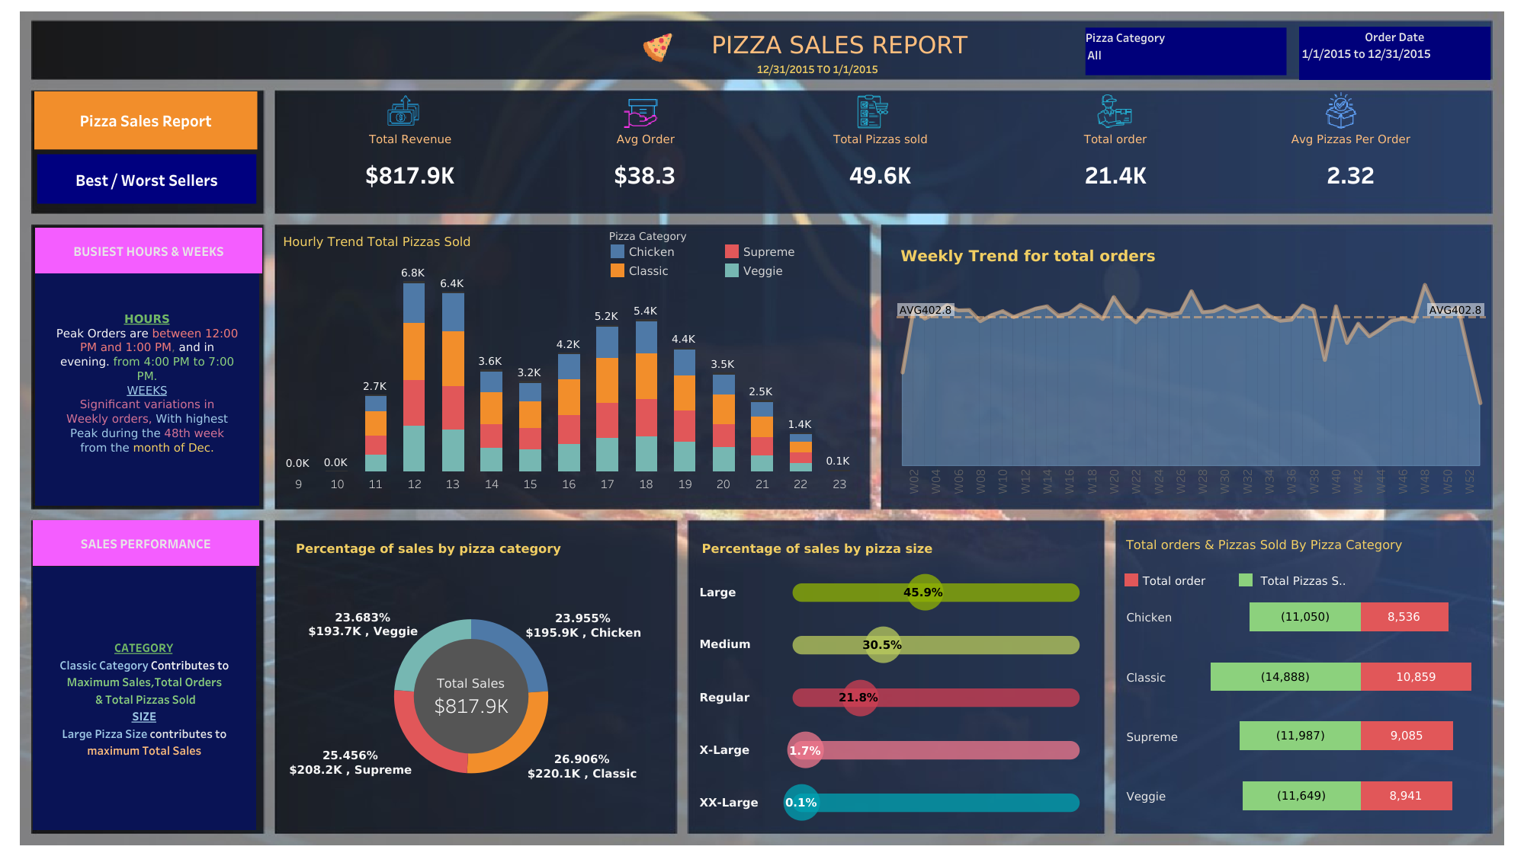

Slide 3
